Slide 1
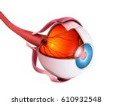
EYE DISEASE DETECTION USING DEEP LEARNING
Presented by
Maliha Haroon [BDA-24F-039]
Muqaddas Bibi [BDA-24F-019]
Department
Software Engineering
Program
BS Data Science, 4A
Presented to
Sir Asif Irshad

Slide 2
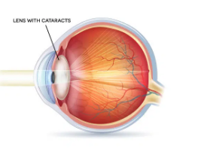
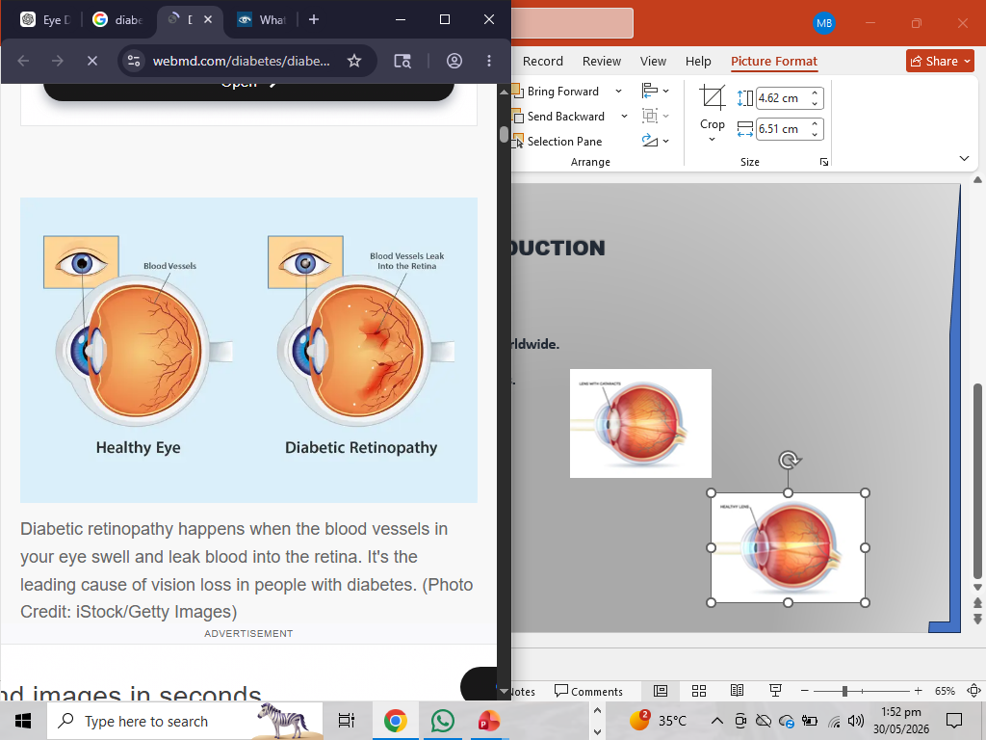
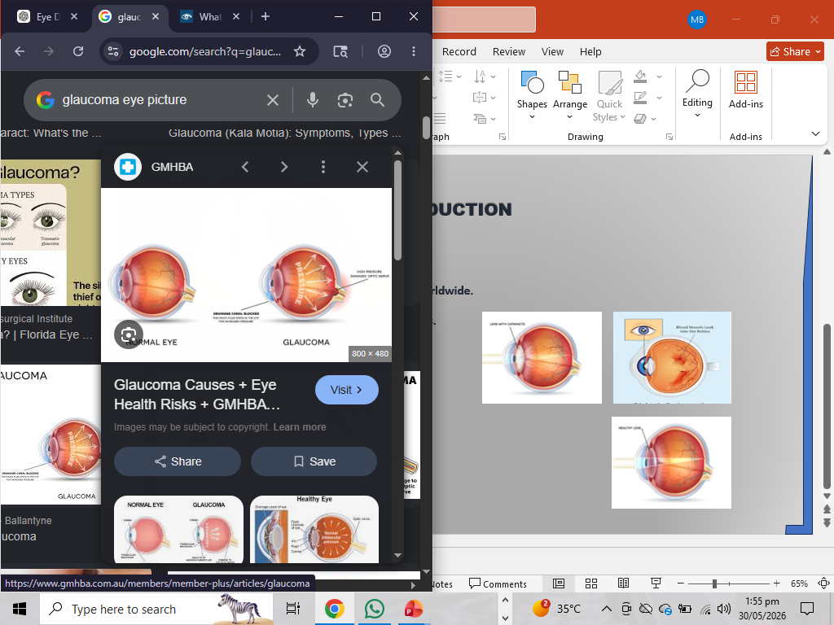
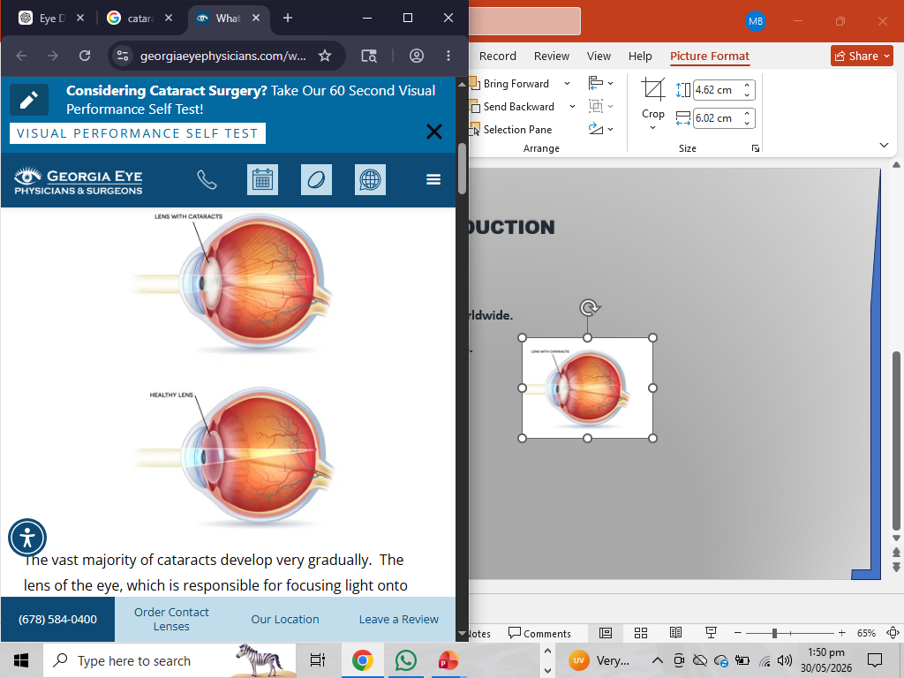
INTRODUCTION
Overview
Eye diseases are a major cause of blindness worldwide.
Early diagnosis helps prevent vision loss.
Many regions lack specialized ophthalmologists.
AI can assist in preliminary screening.
Diseases Detected:
Cataract
Diabetic Retinopathy
Glaucoma
Normal Eye
Cataract
Diabetic Retinopathy
Glaucoma
Normal Eye

Slide 3
PROBLEM STATEMENT
Existing Challenges
Manual diagnosis requires experts.
Screening large populations is time-consuming.
Rural areas have limited access to specialists.
Need for a low-cost automated screening system.
PROJECT OBJECTIVE
Goals
Develop an AI-based eye disease classification system.
Detect four eye conditions from retinal images.
Achieve at least 80% accuracy.
Deploy a user-friendly web application.
Target Accuracy: 80–87%
Achieved Accuracy: 87.2%

Slide 4
DATASET INFORMATION
Dataset Acquisition
Source: Kaggle
Link: https://www.kaggle.com/datasets/gunavenkatdoddi/eye-diseases-classification
Dataset Details
2,100–4,200 retinal fundus images
High-resolution eye images
Classes
Cataract
Diabetic Retinopathy
Glaucoma
Normal

Slide 5
SYSTEM WORKFLOW AND DATA PREPROCESSING
Data Preparation
Steps Performed
Dataset indexing
Train-validation split (80%-20%)
Image resizing to 224×224×3
Normalization using MobileNet preprocessing
Performance Optimization
Cache()
Prefetch(AUTOTUNE)
These techniques improved GPU utilization and reduced training delays.
End-to-End Pipeline
Kaggle Dataset ↓ Data Preprocessing ↓ Data Augmentation ↓ MobileNetV2 Training ↓ Model Saving (.h5) ↓ Gradio Web Interface ↓ Disease Prediction

Slide 6
MODEL ARCHITECTURE
MobileNetV2 Transfer Learning
Why MobileNetV2?
Lightweight CNN architecture
Fast training
Low computational cost
Excellent feature extraction
Transfer Learning
Pretrained on ImageNet
Base layers frozen
Custom classifier added

Slide 7
MODEL SELECTION COMPARISON
YOLO Models
Designed for object detection
Require bounding box annotations
Higher computational complexity
MobileNetV2
Designed for image classification
Works with image-level labels
Faster and more efficient
Therefore MobileNetV2 was selected.

Slide 8
TRAINING CONFIGURATION
Hyperparameters
Parameter | Value
Optimizer | Adam
Learning Rate | 0.001
Loss Function | Categorical Cross Entropy
Batch Size | 32
Epochs | 20
Dropout | 0.2
Regularization
Dropout prevents overfitting.
Improves model generalization.

Slide 9
RESULTS
Model Performance
Training Progress
Epochs 1–5: Accuracy increased from ~70% to ~80%
Epochs 10–20: Stable convergence
Validation loss continuously decreased
Final Result
Validation Accuracy = 87.2%
Target successfully achieved.

Slide 10
CONCLUSION & FUTURE WORK
Conclusion
Successfully developed an eye disease detection system.
Achieved 87.2% validation accuracy.
Deployed through an interactive Gradio web interface.
Lightweight and suitable for preliminary diagnosis.
Future Scope
Larger datasets
Additional eye diseases
Grad-CAM visualization
Fine-tuning MobileNetV2
Target accuracy above 90%

Slide 11
THANK YOU!

